Slide 1
SENTIMENT ANALYSIS ON AMAZON FINE FOOD REVIEWS
By
Jyotsna Eltepu

Slide 2
Objective
The goal of the project is to analyze the Amazon fine food reviews dataset and
perform sentiment classification on it.

Slide 3
Data Wrangling
The Amazon Fine Food Reviews dataset consists of reviews of fine foods from Amazon website.
Number of reviews: 568,454 Number of users: 256,059 Number of products: 74,258 Timespan: Oct 1999 - Oct 2012 Number of Attributes/Columns in data: 10

Slide 4
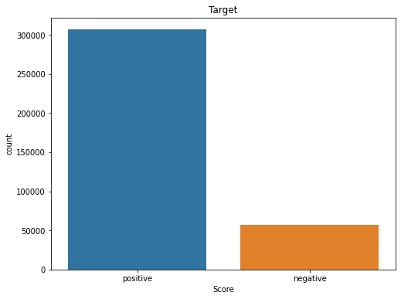
Exploratory Data Analysis
This dataset is skewed as it has a large number of positive reviews and very few negative reviews.
This is an imbalanced dataset.

Slide 5
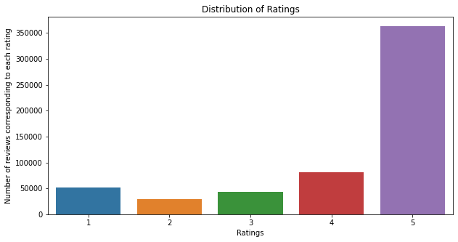
Exploratory Data Analysis

Slide 6
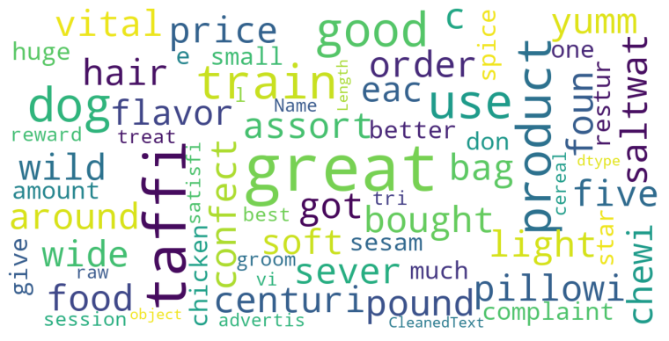
Positive Word Cloud

Slide 7
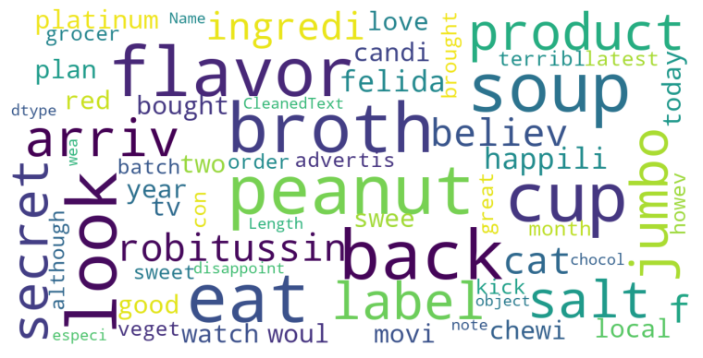
Negative Word Cloud

Slide 8
Model Selection
Two different machine learning classification models were run:
Logistic Regression
Random Forest Classifier
The chosen metric was AUC as we have an imbalanced dataset.
Two methods of vectorization were used TF-IDF and CountVectorizer.

Slide 9
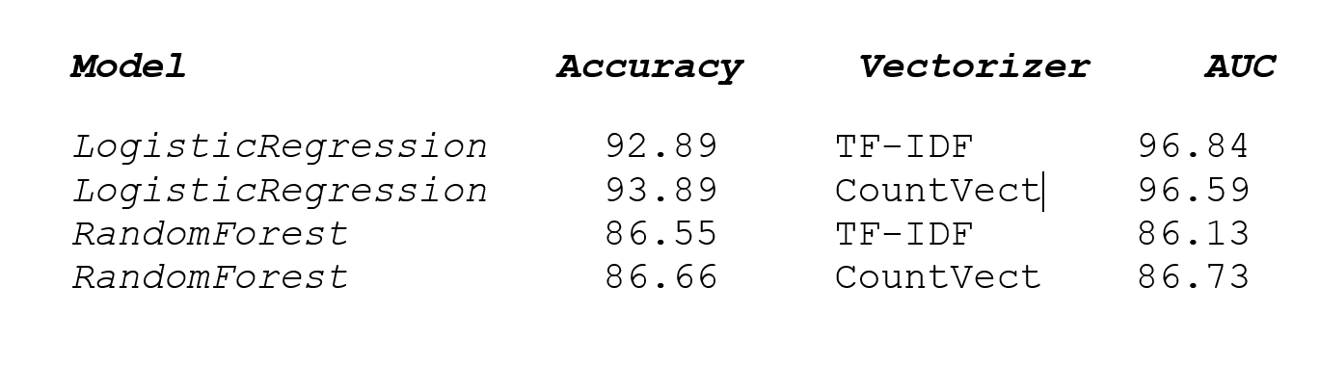
Model Comparison

Slide 10
Conclusion
The Logistic Regression model using the TF-IDF vectorizer is the best model for performing the sentiment analysis for the Amazon fine foods dataset.
We can further try using other methods to vectorize the data like Word2Vec and try different models, like Naïve Byes, KNN, Neural Networks etc. and see if it further enhances the model performance.

Slide 11
Thank You!

